Slide 1






ASP.NET Web Security
SQL Injection, XSS, CSRF, Parameter Tampering, DoS Attacks, Session Hijacking
Svetlin Nakov
Telerik Software Academy
academy.telerik.com

Slide 2
Table of Contents
SQL Injection
Cross Site Scripting (XSS)
Cross-Site Request Forgery (CSRF)
Parameter Tampering

Slide 3

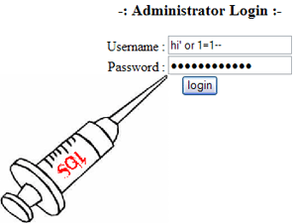

SQL Injection
What is SQL Injection and How to Prevent It?

Slide 4
What is SQL Injection?
protected void ButtonSearch_Click(object sender, EventArgs e)
{
string searchString = this.TextBoxSearch.Text;
string searchSql = "SELECT * FROM Messages WHERE MessageText LIKE '%" + searchString + "%'";
MessagesDbContext dbContext = new MessagesDbContext();
var matchingMessages =
dbContext.Database.SqlQuery<Message>(searchSql).ToList();
this.ListViewMessages.DataSource = matchingMessages;
this.DataBind();
}
Try the following queries:
' → crashes
'; INSERT INTO Messages(MessageText, MessageDate) VALUES ('Hacked!!!', '1.1.1980') → injects a message

Slide 5
How Does SQL Injection Work?
The following SQL commands are executed:
Usual search (no SQL injection):
SQL-injected search (matches all records):
SQL-injected INSERT command:
SELECT * FROM Messages WHERE MessageText LIKE '%nakov%'"
SELECT * FROM Messages WHERE MessageText LIKE '%%%%'"
SELECT * FROM Messages WHERE MessageText LIKE '%' or 1=1 --%'"
SELECT * FROM Messages WHERE MessageText
LIKE '%'; INSERT INTO Messages(MessageText, MessageDate) VALUES ('Hacked!!!', '1.1.1980') --%'"

Slide 6
Preventing SQL Injection
Ways to prevent the SQL injection:
SQL-escape all data coming from the user:
Not recommended: use as last resort only!
Preferred approach:
Use parameterized queries
string searchSql = @"SELECT * FROM Messages
WHERE MessageText LIKE {0} ESCAPE '~'";
string searchString = "%" +
TextBoxSearch.Text.Replace("~", "~~").Replace("%", "~%") + "%";
MessagesDbContext dbContext = new MessagesDbContext();
var matchingMessages =
dbContext.Database.SqlQuery<Message>(searchSql, searchString);

Slide 7
SQL Injection and Prevention
Live Demo

Slide 8
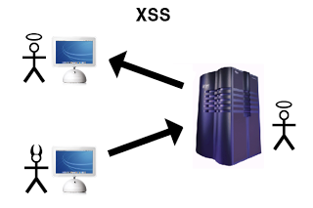
Cross Site Scripting (XSS)
<script>…
<script>…
What is XSS and How to Prevent It?

Slide 9
XSS Attack
Cross-site scripting (XSS) is a common security vulnerability in Web applications
Web application is let to display a JavaScript code that is executed at the client's browser
Crackers could take control over sessions, cookies, passwords, and other private data
How to prevent from XSS?
Validate the user input (built-in in ASP.NET)
Perform HTML escaping when displaying text data in a Web control

Slide 10
Automatic Request Validation
ASP.NET applies automatic request validation
Controlled by the ValidateRequest attribute of Page directive
Checks all input data against a hard-coded list of potentially dangerous values
The default is true
Using it could harm the normal work on most applications
E.g. a user posts JavaScript code in a forum
Escaping is a better way to handle the problem!

Slide 11
Bad Characters Protection
The ASP.NET built-in protection against XSS
By default stops all HTTP requests that send un-escaped HTML code
An error message is shown when a form sends HTML to the server
Disable the HTTP request validation for all pages in Web.config (in <system.web>):
500 Internal Server Error: A potentially dangerous Request.Form value was detected from the client (…)
<httpRuntime requestValidationMode="2.0" />
<pages validateRequest="false" />

Slide 12

What is HTML Escaping?
HTML escaping is the act of replacing special characters with their HTML entities
Escaped characters are interpreted as character data instead of mark up
Typical characters to escape
<, > – start / end of HTML tag
& – start of character entity reference
', " – text in single / double quotes
…

Slide 13
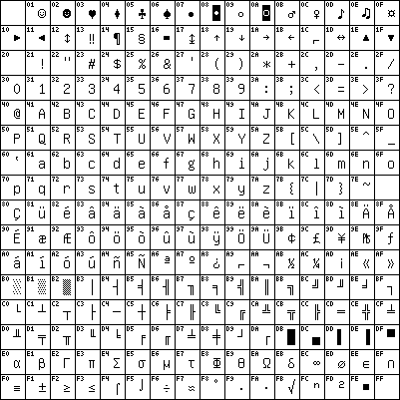
HTML Character Escaping
Each character could be presented as HTML entity escaping sequence
Numeric character references:
'λ' is &#955;, &#x03BB; or &#X03bb;
Named HTML entities:
'λ' is &lambda;
'<' is &lt;
'>' is &gt;
'&' is &amp;
" (double quote) is &quot;

Slide 14
How to Encode HTML Entities?
HttpServerUtility.HtmlEncode
HTML encodes a string and returns the encoded (html-safe) string
Example (in ASPX):
Output:
Web browser renders the following:
<%: "The image tag: <img>" %>
<%response.write(Server.HtmlEncode("The image tag: <img>"))%>
The image tag: &lt;img&gt;
The image tag: <img>

Slide 15
Preventing XSS in ASP.NET MVC
The Razor template engine in ASP.NET MVC escapes everything by default:
To render un-escaped HTML in MVC view use:
@{ ViewBag.SomeText = "<script>alert('hi')</script>"; }
@ViewBag.SomeText
&lt;script&gt;alert(&#39;hi&#39;)&lt;/script&gt;
@{ ViewBag.SomeText = "<script>alert('hi')</script>"; }
@Html.Raw(ViewBag.SomeText)
<script>alert('hi')</script>

Slide 16
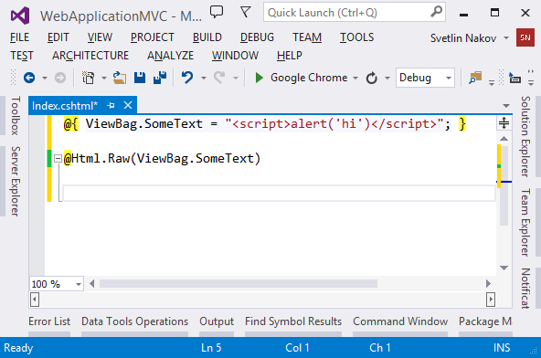
HTML Escaping in Web Forms and MVC Apps
Live Demo
Notes:
*
9/28/201307/16/96
(c) 2005 National Academy for Software Development - http://academy.devbg.org. All rights reserved. Unauthorized copying or re-distribution is strictly prohibited.*
16##

Slide 17

Cross-Site Request Forgery
What is CSRF and How to Prevent It?

Slide 18
What is CSRF?
Cross-Site Request Forgery (CSRF / XSRF) is a web security attack over the HTTP protocol
Allows executing unauthorized commands on behalf of some authenticated user
E.g. to transfer some money in a bank system
The user has valid permissions to execute the requested command
The attacker uses these permissions to send a forged HTTP request unbeknownst to the user
Through a link / site / web form that the user is allured to open

Slide 19
CSRF Explained
How does CSRF work?
The user has a valid authentication cookie for the site victim.org (remembered in the browser)
The attacker asks the user to visit some evil site, e.g. http://evilsite.com
The evil site sends HTTP GET / POST to victim.org and does something evil
Through a JavaScript AJAX request
Using the browser's authentication cookie
The victim.org performs the unauthorized command on behalf of the authenticated user

Slide 20
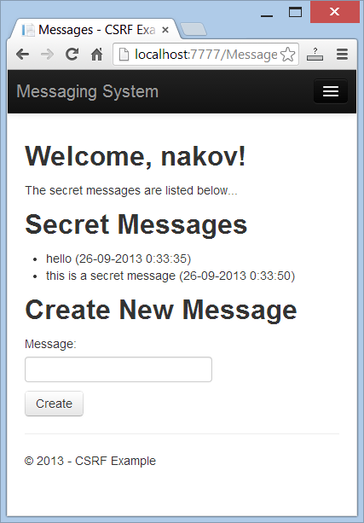
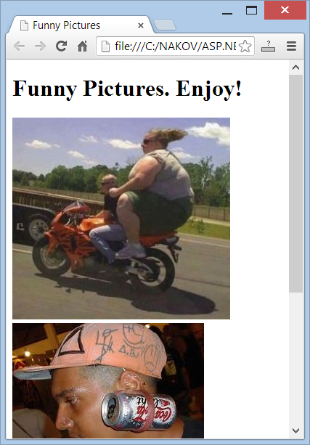
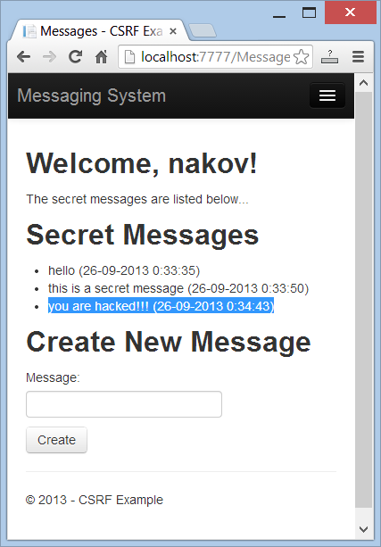
Cross-Site Request Forgery
Live Demo

Slide 21
Prevent CSRF in ASP.NET MVC
To prevent CSRF attacks in MVC apps use anti-forgery tokens
Put the anti-CSRF token in the HTML forms:
Verify the anti-CSRF token in each controller action that should be protected:
@using (@Html.BeginForm("Action", "Controller"))
{
…
@Html.AntiForgeryToken()
}
[ValidateAntiForgeryToken]
public ActionResult Action(…)
{ … }

Slide 22
Prevent CSRF in AJAX Requests
In jQuery AJAX requests use code like this:
Send the token in the AJAX requests:
<%-- used for ajax in AddAntiForgeryToken() --%>
<form id="__AjaxAntiForgeryForm" action="#"
method="post"><%= Html.AntiForgeryToken()%></form>
$.ajax({
type: "post",
dataType: "html",
url: …,
data: AddAntiForgeryToken({ some-data })
});

Slide 23
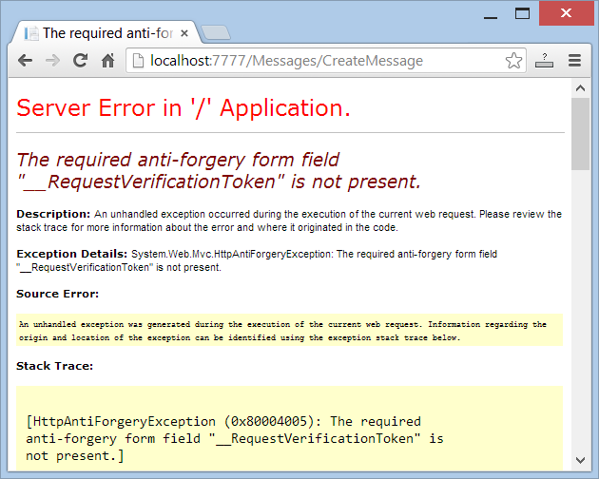
Anti-CSRF in MVC Apps
Live Demo

Slide 24
Prevent CSRF in Web Forms
In Web Forms just add the following code in your Site.Master.cs:
It changes the VIEWSTATE encryption key for all pages when there is a logged-in user
In the VS 2013 Web Forms app template, there is already CSRF protection in Site.master.cs
protected override void OnInit(EventArgs e) {
base.OnInit(e);
if (Page.User.Identity.IsAuthenticated)
{
Page.ViewStateUserKey = Session.SessionID;
}
}

Slide 25
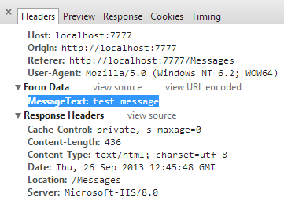
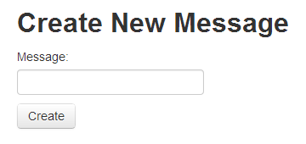
Parameter Tampering
What is Parameter Tampering and How to Prevent It?

Slide 26
What is Parameter Tampering?
What is Parameter Tampering?
Malicious user alters the HTTP request parameters in unexpected way
Altered query string (in GET requests)
Altered request body (form fields in POST requests)
Altered cookies (e.g. authentication cookie)
Skipped data validation at the client-side
Injected parameter in MVC apps

Slide 27
Parameter Tampering
Live Demo

Slide 28
ASP.NET Web Security
http://academy.telerik.com

Slide 29



Free Trainings @ Telerik Academy
"Web Design with HTML 5, CSS 3 and JavaScript" course @ Telerik Academy
html5course.telerik.com
Telerik Software Academy
academy.telerik.com
Telerik Academy @ Facebook
facebook.com/TelerikAcademy
Telerik Software Academy Forums
forums.academy.telerik.com

